Slide 1
Parallel Programming Bubble Sort
Jacob ciurca

Slide 2
Parallel computing
Most programs we have learned so far are run sequentially
Program completes tasks one at a time until everything is competed
Parallel computing completes multiple tasks concurrently in order to speed up execution time

Slide 3
how parallel computing works
Parallel programming takes a larger problem and breaks it down into a series of problems
These problems are then run at the same time
When these problems are completed, they are all merged back together to give you one solution faster than if you were to do each problem sequentially
Makes better use of computer’s resources

Slide 4
Creating a parallel program
Break down larger task into a set of smaller tasks
Assign individual tasks to a thread
Threads are run in parallel with each thread doing a different task
Threads continue to do tasks until they are all finished
Threads are linked back together to create the solution to the program

Slide 5
Computer hardware for parallel computing
Most computers today are made for running in parallel
Multiple CPU cores, GPU, multiple threads all contribute to helping your computer run tasks in parallel
CPU is the most important hardware when talking about parallel computing
The CPU contains CPU cores which house your logical processors
The number of logical processors is directly related to how many tasks you can run in parallel
Most computers today have multiple cores with 2 logical processors per core

Slide 6
Introduction to Bubble sort
Bubble sort is one of the oldest sorting algorithms in computing with references to it dating back to 1962
Very simple algorithm that is considered very inefficient with larger arrays
Average time complexity of bubble sort is O(n^2)

Slide 7
Introduction to bubble sort cont.
Bubble sort is one of the more simple and straight forward algorithms
Bubble sort cycles through the list of elements, compares adjacent elements and swaps them if necessary
Bubble sort stops when all the pairs are properly ordered
Very slow and inefficient

Slide 8
Bubble sort code
for (int i = 0; i < n; i++)
{
bool stop = true;
for (int j = 0; j < n - 1; j++)
{
if (arr1[j] > arr1[j + 1])
{
std::swap(arr1[j], arr1[j + 1]);
stop = false;
}
}
if (stop)
break;
}

Slide 9
Bubble sort in parallel
Odd-even transportation sort otherwise known as brick sort
Essentially a variation of bubble sort that is made to be run in parallel
Compares elements in a list alternating between even and odd phases
Brick sort when run sequentially has the same run time as bubble sort with average case being O(n^2)

Slide 10
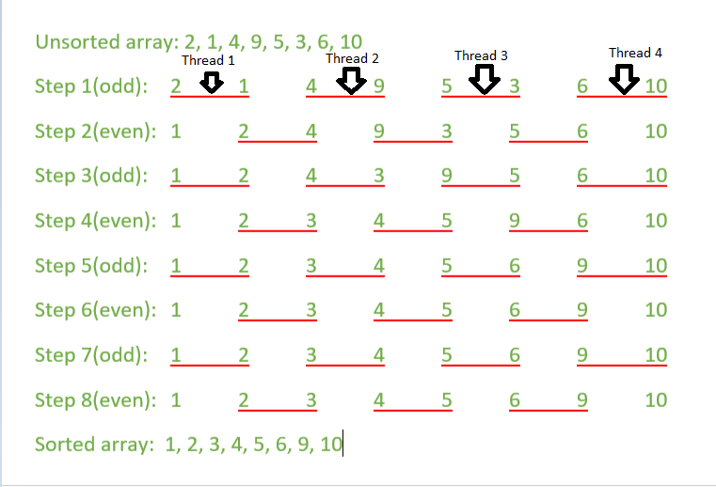

Slide 11
Brick sort
When running brick sort in parallel every comparison is done by a different thread
Speeds up run time significantly
With an infinite number of processors you are reducing the number of comparisons by n-1 for each iteration

Slide 12
Brick sort code
for (int i = 0; i < n; i++)
{
int first = i % 2;
for (int j = first; j < n - 1; j += 2)
{
if (arr[j] > arr[j + 1])
{
std::swap(arr[j], arr[j + 1]);
}
}
}

Slide 13
Implementing brick sort in parallel
C++ openmp was the parallel computing software that I used to implement this algorithm
Openmp allows you to do several different things
omp_get_max_threads() - returns the number of threads available for use on your machine
omp_set_num_threads(); - allows you to set the number of threads you want to use
#pragma omp parallel tells the machine that you want to run the code below this statement in parallel

Slide 14
Openmp Software
When implementing the function you want to have the inner for loop run in parallel
In order keep the same array across all threads you need to define the array as shared
#pragma omp parallel for default(none),shared(arr,first)
Defines the for loop below this statement to be run in parallel with each thread sharing the same array of elements
Threads must share the array because each thread would get its own array otherwise, causing the array to be sorted incorrectly

Slide 15
Algorithm speed up analysis
Bubble sort run sequentially is one of the slowest sorting algorithms
Average case O(n^2)
When run in parallel this is sped up considerably
With an infinite number of processors doing n-1 comparisons for each iteration, the average case for bubble sort run in parallel is reduced to O(n)
This makes parallel bubble sort even faster than the quickest of sequential algorithms which is Sequential Quicksort with an average run time of O(nlogn)

Slide 16
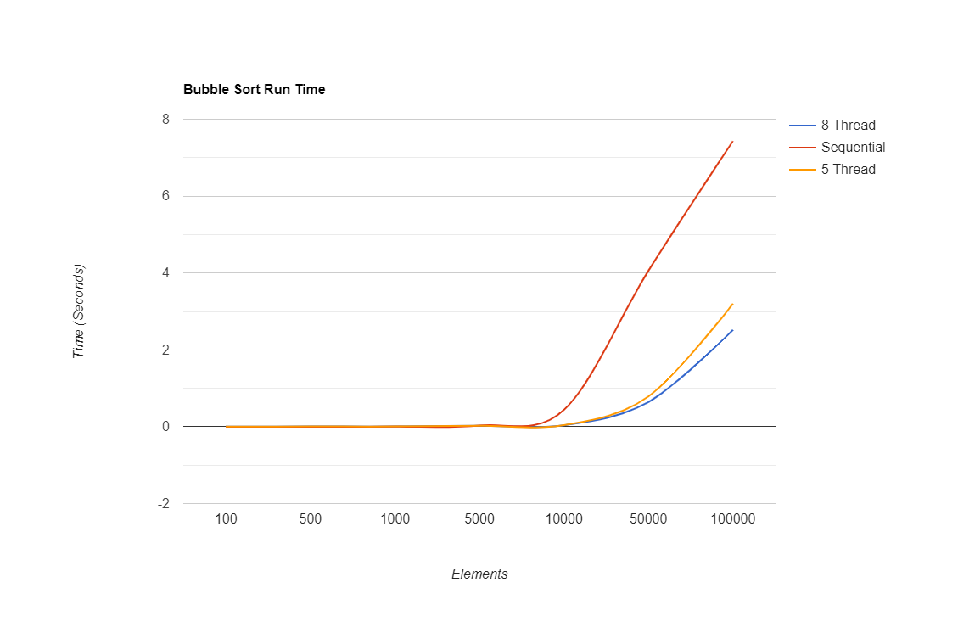

Slide 17
Drawbacks of running in parallel
Linking threads back together takes time
This causes the run time to lengthen as additional time is needed to link threads
For smaller arrays this makes sorting them in parallel slower than if they were run sequentially
This additional time is negligible when dealing with arrays of massive size therefore causing parallel sorting to only be truly useful for arrays of very large size

Slide 18
Drawbacks of running in parallel cont.
While the time complexity of parallel sorting is much faster, the work complexity stays the same
You are still doing the same number of comparisons you would when running sequentially
Does not make the algorithm itself any more efficient it just makes it faster

Slide 19
Real world applications of parallel bubble
In quantum field theory, you frequently encounter strings of operators a† b† c† d†
The question is whether the terms cancel each other out or if there is a remainder
(a†* c† *b†)+(a† b† c†) =0
(c† a† b†)+(a† b† c†) =2⋅a† b† c†
The terms in the first term differ by an odd number of swaps and in the second term they differ by an even number
When there are 100 operators and 10,000 permutations it’s impossible to keep track of the number of swaps by hand
With Parallel bubble sort you can keep track of the number of swaps for each permutations

Slide 20
References
Anastasio, T. A. (2004, January 07). Asymptotic Analysis. Retrieved December 07, 2020, from http://faculty.salisbury.edu/~ealu/COSC320/Lectures/asymptotic.pdf
Bubble Sort In C++ With Examples. (2020, November 13). Retrieved December 08, 2020, from https://www.softwaretestinghelp.com/bubble-sort/
Bubble Sort. (2020, September 30). Retrieved December 08, 2020, from https://www.geeksforgeeks.org/bubble-sort/
Introduction to Parallel Computing Tutorial. (n.d.). Retrieved December 10, 2020, from https://hpc.llnl.gov/training/tutorials/introduction-parallel-computing-tutorial
Odd-Even Sort / Brick Sort. (2018, April 14). Retrieved December 08, 2020, from https://www.geeksforgeeks.org/odd-even-sort-brick-sort/
Saadeh, R., & Qatawneh, M. (2019, June). Performance Evaluation of Parallel Bubble Sort Algorithm on Supercomputer IMAN1. Retrieved November 20, 2020, from https://www.researchgate.net/publication/334131761_Performance_Evaluation_of_Parallel_Bubble_Sort_Algorithm_on_Supercomputer_IMAN1

